Slide 2
Developing with Brightcove Player
Matt Boles, Learning Specialist
mboles@brightcove.co or training@brightcove.com

Slide 3
Introducing the Course

Slide 4
What: Brightcove Player
The Brightcove Player is based on the Video.js Player
Three core elements:
Video embed code - Places a video into a website using the HTML5 <video> element falling back to Flash automatically
JavaScript library - Makes the player work across browsers, their various versions and around device / platform bugs
Pure HTML/CSS skin - Creates a uniform look across HTML5 browsers and easy custom skinning for a branded look

Slide 5
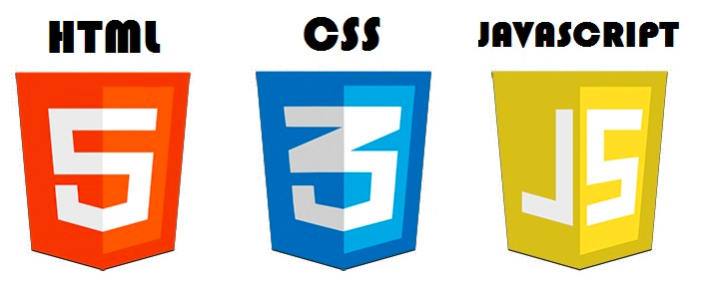
What: Brightcove Player Development
Used to customize, integrate with, or add functionality to, your players
Uses HTML5, CSS, JavaScript and the Player API
Cross-platform standards
Developer-friendly technologies

Slide 6
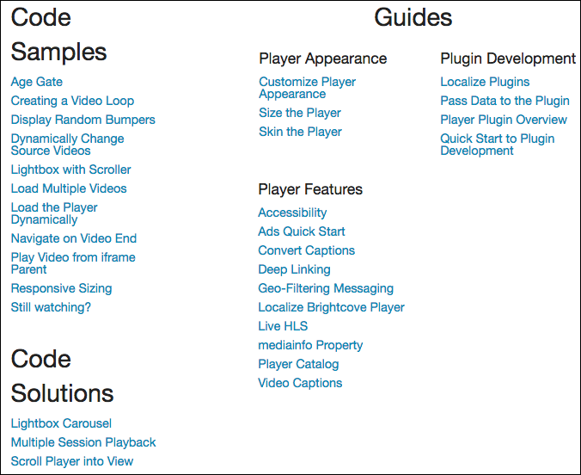
Why: Code Samples and Solutions
http://docs.brightcove.com/en/video-cloud/brightcove-player/index.html

Slide 7
How: Agenda
Introducing the Course
Setting Up to Develop with Brightcove Player
Understanding the Brightcove Player API
Using JavaScript with Brightcove Player
Getting Started with Brightcove Player Development
Demo 1: Using the API to Play a Video
Using the Player Catalog
Demo 2: Dynamically Loading and Playing a Video

Slide 8
How: Agenda (cont)
Using the iframe Player Implementation
Demo 3: Changing the Video in an iframe Player Implementation
Adding a Brightcove Plugin to a Player
Demo 4: Adding the Overlay Plugin to a Player
AND/OR
Demo 5: Using the IMA Plugin to Play VAST Ads

Slide 9
Prerequisites
The session is designed for developers with basic HTML and JavaScript experience

Slide 10
Setting Up to Develop with Brightcove Player

Slide 11
Setup
Video Cloud Account
You will also need an editor for HTML/JavaScript
Any plain text editor will work
An editor such as Chocolat, Sublime Text, Dreamweaver, BBEdit, or CoffeeCup, that provides code-hinting and syntax highlighting is recommended
For iframe player implementation examples a web server is needed
XAMPP and WAMP free options

Slide 12
Getting Session Materials
Student files and slides
https://github.com/BrightcoveLearning/curriculum-developing-bc-player
http://bit.ly/1EDWaCA
PUT SCREEN SHOT HERE OF GITHUB

Slide 13
Brightcove Player API Documentation
Consists of the Video.js API PLUS Brightcove Player additions
Cumulative doc here:
http://docs.brightcove.com/en/video-cloud/brightcove-player/reference/api/index.html
Focus in this session on methods and events (vjs.player):
http://docs.brightcove.com/en/video-cloud/brightcove-player/reference/api/vjs.Player.html

Slide 14
Using JavaScript with Brightcove Player

Slide 15
JavaScript Code Dilemma
Purpose of this session is to teach Smart Player API code
Decided it is not appropriate to suggest too many best practices in JavaScript
Good pattern to use is a basic version of the Module pattern
Keeps variables out of the global name space to avoid collisions with other scripts used in the page
All variable initialized at the top to make it easier to find them
Allows you to have both public and private data/functions
Used in numerous document solutions

Slide 16
API Is Event Driven
function foo() {
player = this;
player.loadVideo(123);
player.play();
}
videojs("video").ready(function(){
var myPlayer = this;
});
otherComponent.on("play", function(){
//Video is playing
});

Slide 17
Callback Function Implemenations
Anonymous Function
videoPlayer.getCurrentVideo(function(videoDTO) {
document.getElementById("displayName").
innerHTML = videoDTO.displayName;
});
OR
Function Expression / Declaration
videoPlayer.getCurrentVideo(onGetVideo);
var onGetVideo = function(videoDTO) {
document.getElementById("displayName").
innerHTML = videoDTO.displayName;
};

Slide 18
Getting Started with Brightcove Player Development

Slide 19
Get Reference to Player
Create a <script> block
Use the ready method
Create variable that holds reference to the player instance
videojs("myPlayerID").ready(function(){
var myPlayer = this;
});
**Do not have to use ready if you are certain Flash fallback never used

Slide 20
Player Methods
Docs: http://docs.brightcove.com/en/video-cloud/brightcove-player/reference/api/vjs.Player.html
Method example
myPlayer.play();

Slide 21
Player Events
Docs: http://docs.brightcove.com/en/video-cloud/brightcove-player/reference/api/vjs.Player.html
Use on() and off() methods to add and remove event listeners
Event example
myPlayer.on("timeupdate", showUpdate);

Slide 22
Demo 1: Using the API to Play a Video and Display Event Object

Slide 23
Using the Player Catalog

Slide 24
Player Catalog
Player Catalog is a helper library for making requests to the Video Cloud catalog
The catalog makes it easy to get information on Video Cloud media and loads them into a player
Currently two methods
myPlayer.catalog.getVideo(videoID,callback)
myPlayer.catalog.load(videoObject)

Slide 25
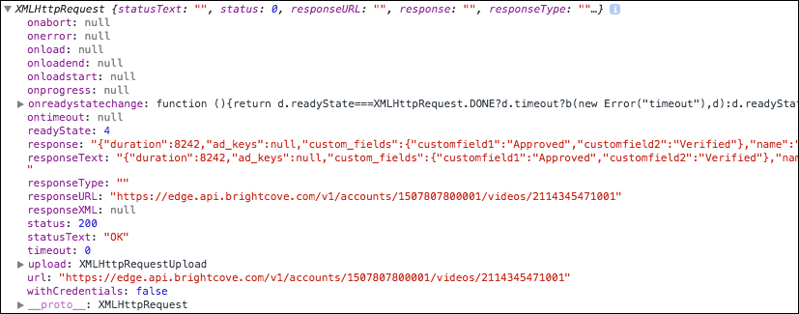
Returned Object from getVideo()
Catalog returns an object of type XMLHttpRequest

Slide 26
Demo 2: Dynamically Loading and Playing a Video

Slide 27
Using the mediainfo Property

Slide 28
mediainfo Property
The mediainfo property is an object which contains information on the current media in the player
The property is created and populated when using the load() method from Brightcove Player's catalog object
After the mediainfo object is populated, use it for convenient data retrieval when wishing to display video information, like the video name or description

Slide 29
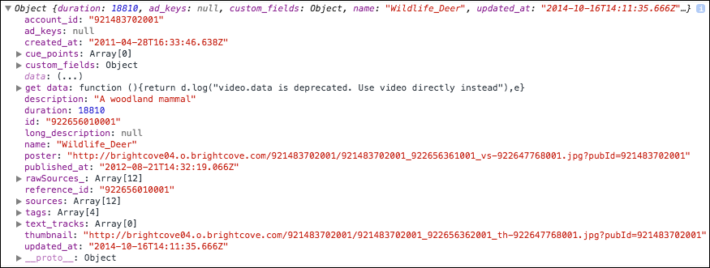
Data in mediainfo

Slide 30
Access mediainfo Data
Access the data in the mediainfo object by simple object.property notation
dynamicHTML = "<p>Video Title: <strong>" + myPlayer.mediainfo.name + "</strong></p>";
dynamicHTML += "<p>Description: <strong>" + myPlayer.mediainfo.description + "</strong></p>";
document.getElementById("textTarget").innerHTML = dynamicHTML;

Slide 31
Demo 3: Display Video Information in the HTML Page

Slide 32
Using the iframe Player Implementation

Slide 33
Advantages of iframe Player Implementation
No collisions with existing JavaScript and/or CSS
Automatically responsive (nearly)
The iframe eases use in social media apps (or whenever the video will need to "travel" into other apps)
Simple localization

Slide 34
When You Cannot Use iframe Implementation
Code in the containing page needs to listen for and act on player events
The player uses styles from the containing page
The iframe will cause app logic to fail, like a redirect from the containing page

Slide 35
Dynamically Change Video in iframe

Slide 36
B
O

Slide 37
B
O

Slide 38
B
O

Slide 39
Demo 4: Changing the Video in an iframe Player Implementation

Slide 40
Adding a Brightcove Plugin to a Player

Slide 41
B
O

Slide 42
B
O

Slide 43
B
O

Slide 44
B
O

Slide 45
B
O

Slide 46
B
O

Slide 47
Demo 5: Adding the Overlay Plugin to a Player AND/OR Demo 6: Using the IMA Plugin to Play VAST Ads

Slide 48
Creating and Using a Plugin

Slide 49
B
O

Slide 50
B
O

Slide 51
B
O

Slide 52
B
O

Slide 53
B
O

Slide 54
B
O

Slide 55
Demo 6: Creating a Localizing Plugin and Adding it to a Player

Slide 56
Bulleted lists layout on dark background
Occaecat viral adipisicing, in tattooed aliquip laborum chambray
Distillery fanny pack, Blue Bottle tofu pork belly
Distillery 90's cray, Austin deep v
Locavore sriracha ugh pickled adipisicing cupidatat,
Semiotics consectetur
Echo Park asymmetrical

Slide 57
Two elements layout
thnic mixtape odio iPhone authentic. Actually Echo Park flexitarian Portland, slow-carb ut pickled irony enim odio
deep v chillwave you probably Banksy
Richardson. Tumblr ut irony biodiesel consectetur.
Velit farm-to-table Wes Anderson Intelligentsia repreh
Keytar aute
kogi nihil cray ad Farm-to-table jean shorts cardigan
Odd future fanny pack.
fanny pack
fingerstache ad
quinoa readymade
mumblecore in delectus

Slide 58
Two elements layout on dark background
thnic mixtape odio iPhone authentic. Actually Echo Park flexitarian Portland, slow-carb ut pickled irony enim odio
deep v chillwave you probably Banksy
Richardson. Tumblr ut irony biodiesel consectetur.
Velit farm-to-table Wes Anderson Intelligentsia repreh
Keytar aute
kogi nihil cray ad Farm-to-table jean shorts cardigan
Odd future fanny pack.
fanny pack
fingerstache ad
quinoa readymade
mumblecore in delectus

Slide 59
Centered list layout
Tattooed cupidatat
Locavore sriracha
Semiotics consectetur
Cardigan DIY
Squid deserunt cray swag
Polaroid occupy irony

Slide 60
Paragraph with title layout
Proident salvia chambray
Sunt +1 blog Pinterest, est swag literally nihil American Apparel XOXO sriracha street art. Paleo semiotics sartorial meggings typewriter. Godard vegan chillwave aliquip Vice, street art slow-carb laboris Pitchfork organic incididunt. DIY gluten-free direct trade irony fap Tonx food truck. Semiotics veniam drinking vinegar nostrud leggings four loko nesciunt, delectus kogi. Cliche ethical street art, typewriter whatever exercitation ex est synth Godard skateboard four loko. Ethnic disrupt mustache, pickled gastropub Banksy enim.

Slide 61
Paragraph with pullquote
“Roof party labore id typewriter nesciunt, meggings placeat mlkshk.”
—Firstname, Lastname
Velit id whatever, 3 wolf moon you probably haven't heard of them veniam wolf gastropub blog brunch dolor. Roof party labore id typewriter nesciunt, meggings placeat mlkshk American Apparel ad. Williamsburg in pour-over, occupy Cosby sweater DIY sapiente duis swag artisan. Whatever Austin brunch church-key 90's, cred American Apparel selvage chia occaecat sustainable synth Pitchfork.

Slide 62
Product title slides

Slide 68
Solutions title slides

Slide 69
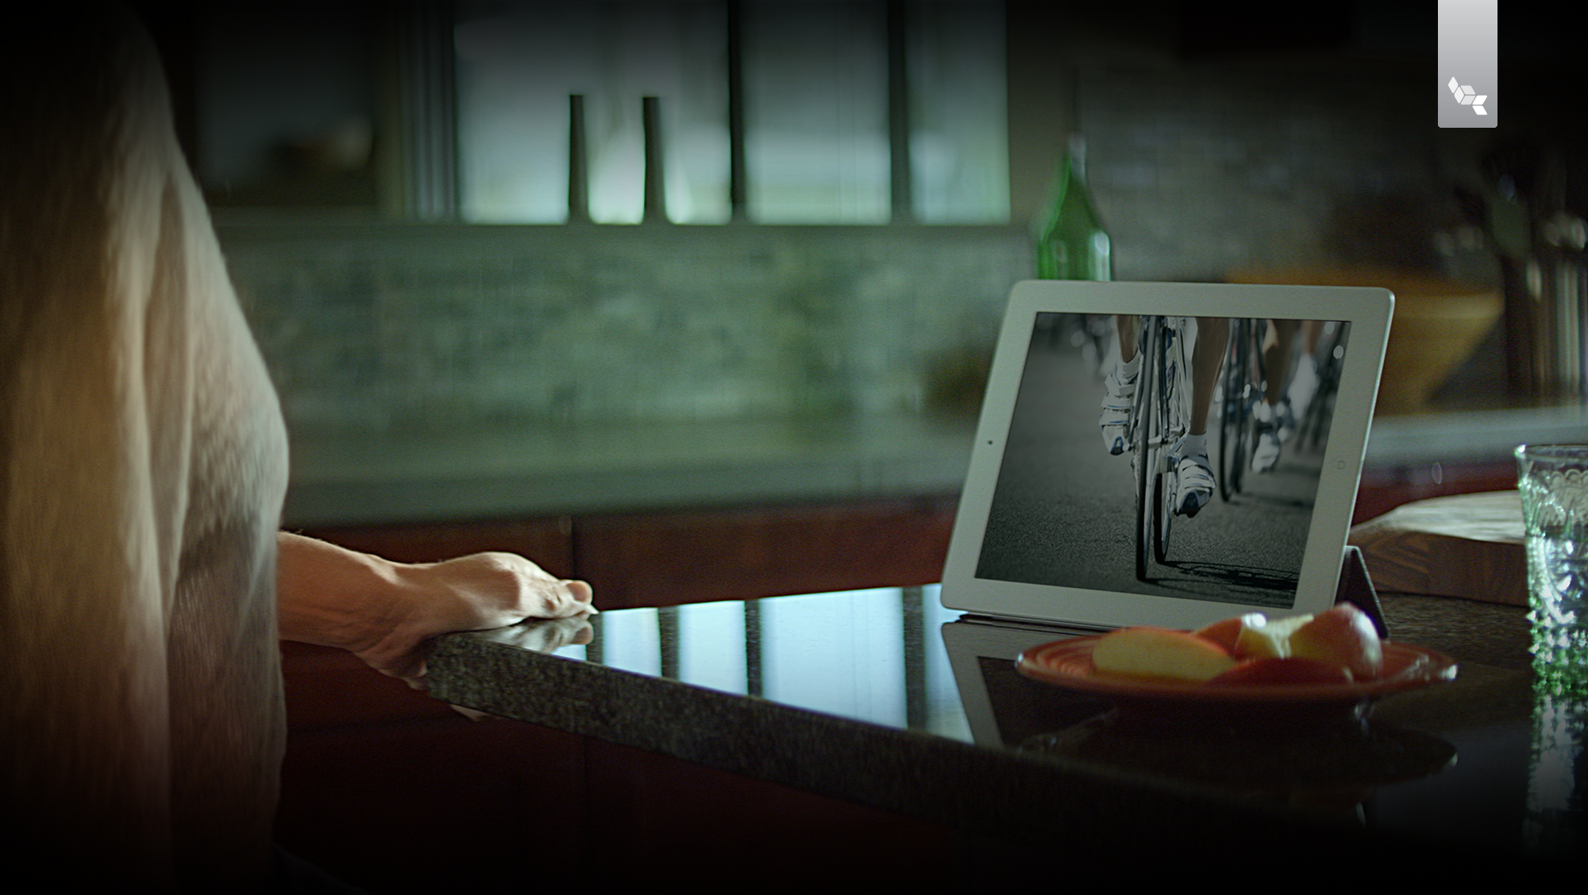
Build for the future and easily monetize across all screens with the leader in video platform solutions.

Slide 70
Captivate customers, drive demand and increase conversions with reliable, video rich experiences on every device.

Slide 71
Empower your business with secure, scalable solutions for video distribution across the enterprise.

Slide 72
Alternate Section Divider

Slide 73
Alternate Section Divider

Slide 74
Alternate title slide

